Slide 1
Named Entity Recognition for Social Media Texts with Semantic Augmentation
Yuyang Nie, Yuanhe Tian , Xiang Wan, Yan Song, Bo Dai
University of Electronic Science and Technology of China
University of Washington Shenzhen Research Institute of Big Data
EMNLP-2020
罗辉
Github：https://github.com/cuhksz-nlp/SANER.

Slide 2
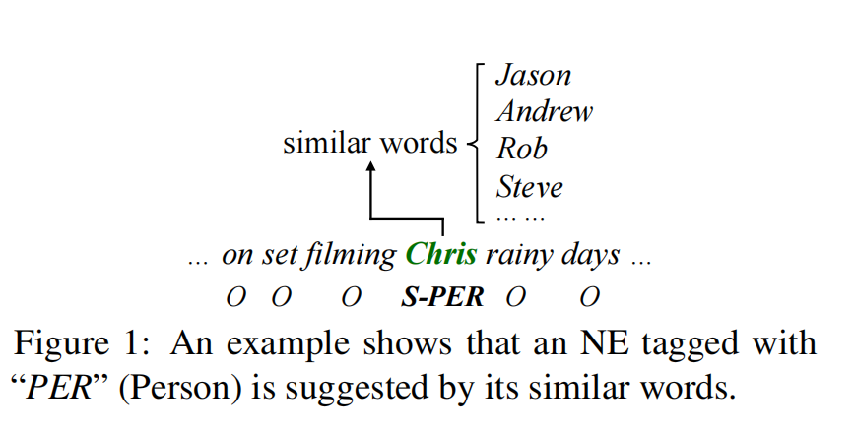
Introduction

Slide 3

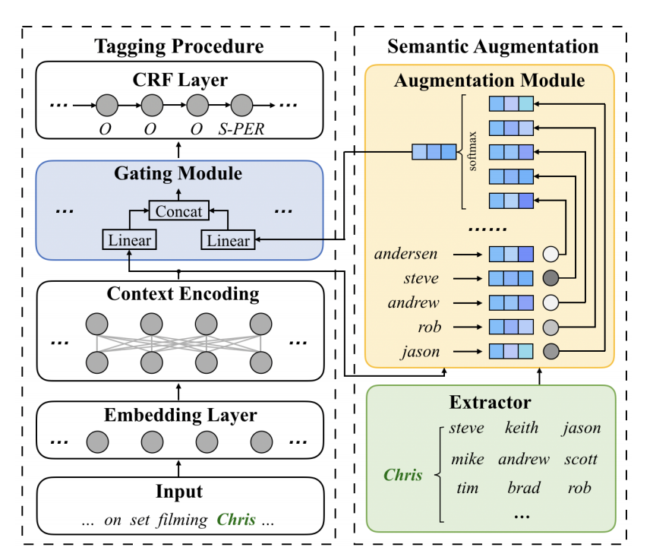






Model

Slide 4
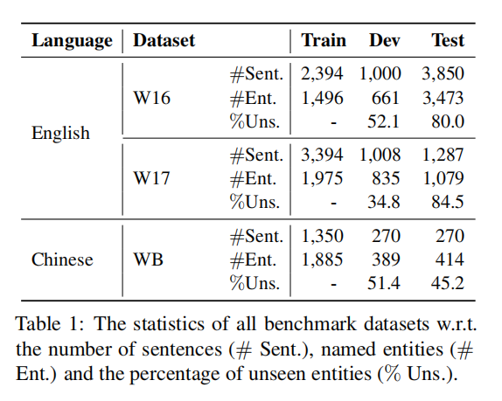
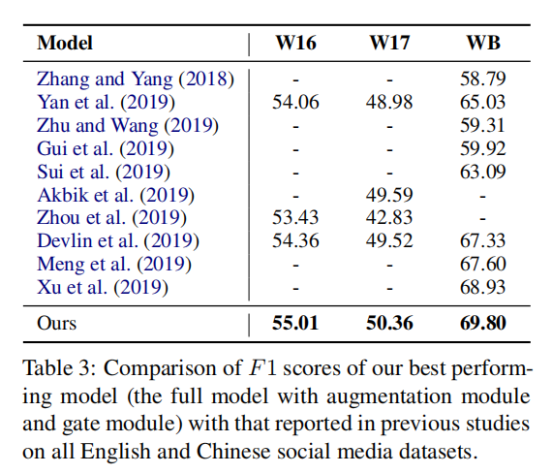
Experiments

Slide 5
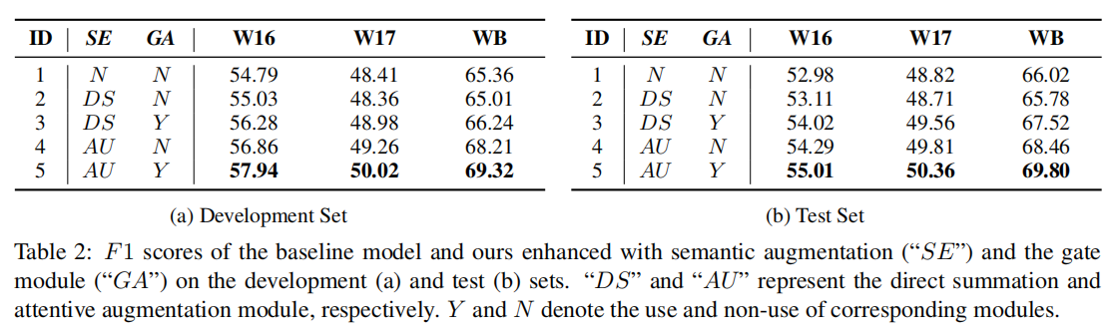

Slide 6
